Slide 1
Cache Coherency Lecture
Slides from Professor Fernandez and M. Lancaster
Snooping Protocol

Slide 2
Multiprocessor Shared Memory Problem Cache Review
Processor A
Processor B
Processor C
Processor D
Inclusion
L1
L1
L1
L1
Every data entry in the L1 cache will also be stored in the L2 cache. Data in the L2 cache should be present in the L3 cache if available, and so forth up the hierarchy.
If a data block is evicted from a higher-level cache (like L2), the corresponding data in the lower-level caches (like L1) should also be evicted to maintain inclusion.
L2
L2
L3
Memory
CSCI 6461 Lancaster

Slide 3
Multiprocessor Shared Memory Problem Cache Review
Processor A
Processor B
Processor C
Processor D
Write through or
write back?
L1
L1
L1
L1
Write through: When cache is updated, the corresponding data in the main memory is also immediately updated and main memory always has the latest data, making it easier to maintain data consistency across different caches.
Write back: Data not written back to memory immediately, it is marked as dirty. It is written to memory only when it is evicted and it is dirty.
L2
L2
L3
Memory
CSCI 6461 Lancaster

Slide 4
Multiprocessor Shared Memory Problem Cache Review
Processor A
Processor B
Processor C
Processor C
Write allocate or
write no allocate?
L1
L1
L1
L1
L2
L2
Write allocate: When a write miss occurs, the data block is loaded into the cache before the write.
Write no-allocate: When a write miss occurs, data is written to main memory without allocating it to cache.
L3
Memory
CSCI 6461 Lancaster

Slide 5
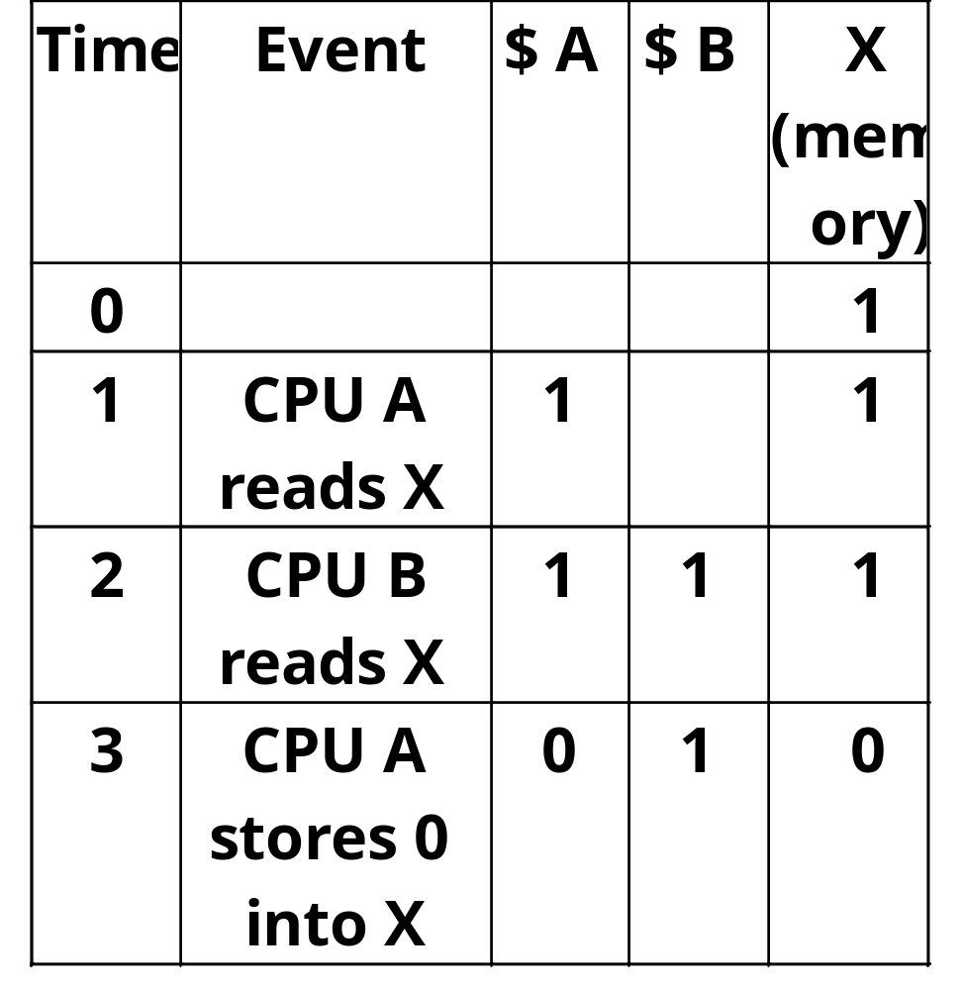
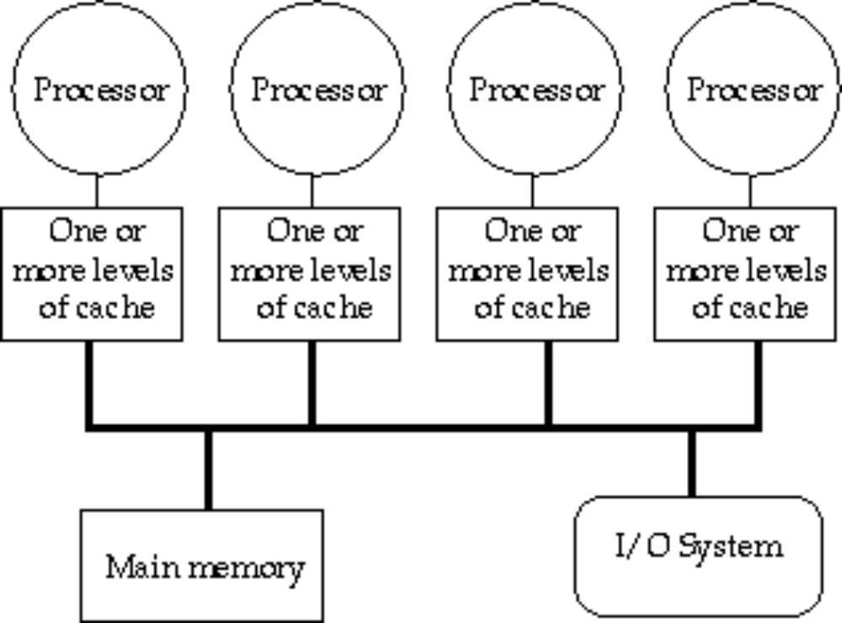
Small-Scale—Shared Memory Problem
Caches serve to:
  Increase bandwidth versus bus/memory
  Reduce latency of access
  Valuable for both private data and shared data
What about cache consistency?

Slide 6
What Does Coherency Mean?
Informally:
  “Any read must return the most recent write”
  Too strict and too difficult to implement
Better:
  “Any write must eventually be seen by a read”
  All writes are seen in proper order (“serialization”)
Two rules to ensure this:
  “If P writes x and P1 reads it, P’s write will be seen by P1 if the read and write are sufficiently far apart”
  Writes to a single location are serialized:
  seen in one order
    Latest write will be seen
    Otherwise could see writes in illogical order
    (could see older value after a newer value)

Slide 7
Potential HW Coherency Solutions
Snooping Solution (Snoopy Bus):
  Send all requests for data to all processors
  Processors snoop to see if they have a copy and respond accordingly
  Requires broadcast, since caching information is at processors
  Works well with bus (natural broadcast medium)
  Dominates for small scale machines (most of the market)
Directory-Based Schemes (discuss later)
  Keep track of what is being shared in 1 centralized place (logically)
  Distributed memory => distributed directory for scalability
  (avoids bottlenecks)
  Send point-to-point requests to processors via network
  Scales better than Snooping
  Actually existed BEFORE Snooping-based schemes

Slide 8
Basic Snoopy Protocols
Write Invalidate Protocol:
  Multiple readers, single writer
  Write to shared data: an invalidate is sent to all caches which snoop and invalidate any copies
  Read Miss:
    Write-through: memory is always up-to-date
    Write-back: snoop in caches to find most recent copy
Write Broadcast Protocol (typically write through):
  Write to shared data: broadcast on bus, processors snoop, and update any copies
  Read miss: memory is always up-to-date
Write serialization: bus serializes requests!
  Bus is single point of arbitration

Slide 9
Basic Snoopy Protocols
Write Invalidate versus Broadcast:
  Invalidate requires one transaction per write-run
  Invalidate uses spatial locality: one transaction per block
  Broadcast has lower latency between write and read

Slide 10
Snooping Cache Variations
Basic
Protocol
Exclusive
Shared
Invalid
Berkeley
Protocol
Owned Exclusive
Owned Shared
Shared
Invalid
Illinois
Protocol
Private Dirty
Private Clean
Shared
Invalid
MESI
Protocol
Modified (private,!=Memory)
eXclusive (private,=Memory)
Shared (shared,=Memory)
Invalid
Owner can update via bus invalidate operation
Owner must write back when replaced in cache
If read sourced from memory, then Private Clean
if read sourced from other cache, then Shared
Can write in cache if held private clean or dirty

Slide 11
An Example Snoopy Protocol
Invalidation protocol, write-back cache
Each block of memory is in one state:
  Clean in all caches and up-to-date in memory (Shared)
  OR Dirty in exactly one cache (Exclusive)
  OR Not in any caches
Each cache block is in one state (track these):
  Shared : block can be read
  OR Exclusive : cache has only copy, its writeable, and dirty
  OR Invalid : block contains no data
Read misses: cause all caches to snoop bus
Writes to clean line are treated as misses

Slide 12
Snoopy-Cache State Machine-I
CPU Read hit
State machine
for CPU requests
for each
cache block
CPU Read
Shared
(read/only)
Invalid
Place read miss
on bus
CPU Write
Place Write
Miss on bus
CPU read miss
Write back block,
Place read miss
on bus
CPU Read miss
Place read miss
on bus
CPU Write
Place Write Miss on Bus
Cache Block
State
Exclusive
(read/write)
CPU read hit
CPU write hit
CPU Write Miss
Write back cache block
Place write miss on bus
Notes:
Invalid:
read => shared
write => dirty
shared looks the same

Slide 13
Snoopy-Cache State Machine-II
State machine
for bus requests
for each
cache block
Appendix E? gives details of bus requests
Write miss
for this block
Invalid
Shared
(read/only)
Write miss
for this block
Write Back
Block; (abort
memory access)
Read miss
for this block
Write Back
Block; (abort
memory access)
Exclusive
(read/write)

Slide 14
Snoopy-Cache State Machine-III
CPU Read hit
State machine
for CPU requests
for each
cache block and
for bus requests
for each
cache block
Write miss
for this block
CPU Read
Shared
(read/only)
Invalid
Place read miss
on bus
CPU Write
Place Write
Miss on bus
Write miss
for this block
CPU read miss
Write back block,
Place read miss
on bus
CPU Read miss
Place read miss
on bus
Write Back
Block; (abort
memory access)
CPU Write
Place Write Miss on Bus
Cache Block
State
Write Back
Block; (abort
memory access)
Read miss
for this block
Exclusive
(read/write)
CPU read hit
CPU write hit
CPU Write Miss
Write back cache block
Place write miss on bus
Notes:
Invalid:
read => shared
write => dirty
shared looks the same

Slide 15
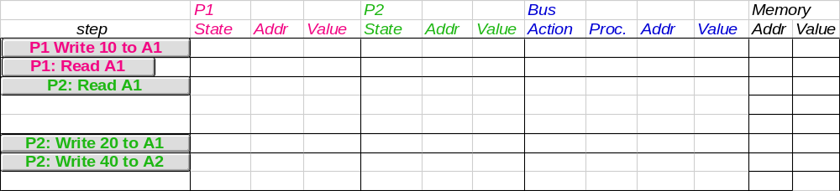
Example
Assumes A1 and A2 map to same cache block,
initial cache state is invalid

Slide 16
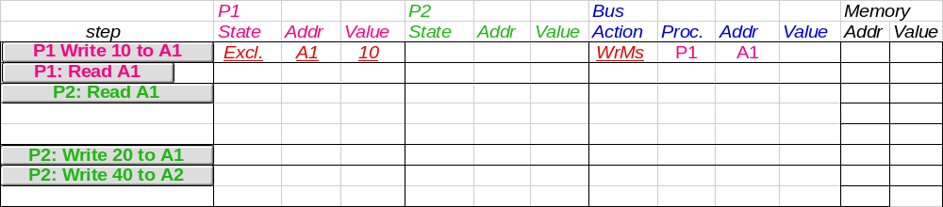
Example
Assumes A1 and A2 map to same cache block

Slide 17
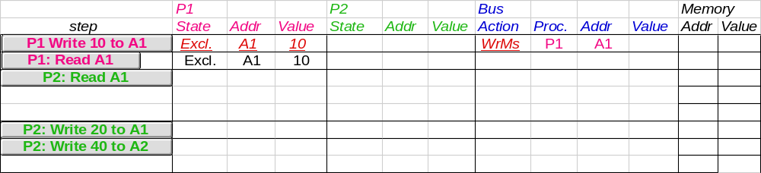
Example
Assumes A1 and A2 map to same cache block

Slide 18
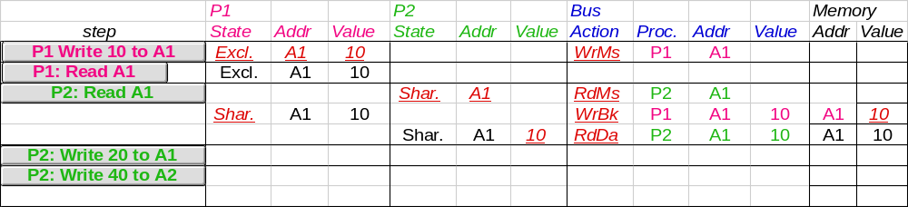
Example
Assumes A1 and A2 map to same cache block

Slide 19
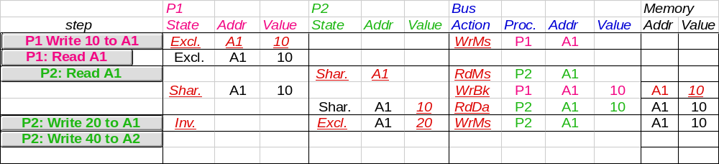
Example
Assumes A1 and A2 map to same cache block

Slide 20
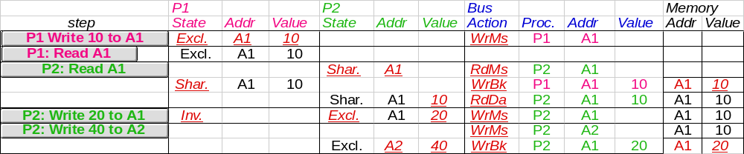
Example
Assumes A1 and A2 map to same cache block,
but A1 != A2
Notes:
Why write miss first?
Because in general, only write a piece of block, may need to read it first so that can have a full vblock; therefore, need to get
Write back is low priority event.

Slide 21
Implementation Complications
Write Races:
  Cannot update cache until bus is obtained
    Otherwise, another processor may get bus first,
    and then write the same cache block!
  Two step process:
    Arbitrate for bus
    Place miss on bus and complete operation
  If miss occurs to block while waiting for bus,
  handle miss (invalidate may be needed) and then restart.
  Split transaction bus:
    Bus transaction is not atomic:
    can have multiple outstanding transactions for a block
    Multiple misses can interleave,
    allowing two caches to grab block in the Exclusive state
    Must track and prevent multiple misses for one block
Must support interventions and invalidations

Slide 22
Implementing Snooping Caches
Multiple processors must be on bus, access to both addresses and data
Add a few new commands to perform coherency,
in addition to read and write
Processors continuously snoop on address bus
  If address matches tag, either invalidate or update
Since every bus transaction checks cache tags,
could interfere with CPU just to check:
  solution 1: duplicate set of tags for L1 caches just to allow checks in parallel with CPU
  solution 2: L2 cache already duplicate,
  provided L2 obeys inclusion with L1 cache
    block size, associativity of L2 affects L1

Slide 23
Implementing Snooping Caches
Bus serializes writes, getting bus ensures no one else can perform memory operation
On a miss in a write back cache, may have the desired copy and its dirty, so must reply
Add extra state bit to cache to determine shared or not
Add 4th state (MESI)

